Slide 1
Instruction-Level Parallelism

Slide 2
Objectives and Reading
Objectives
Understand concepts of instruction-level parallelism, and challenges of exploiting it
Review of pipelining hazards, and their handling
Reading
Appendix C.2 – C.3, C.5
Chapter 3.1

Slide 3
Instruction Execution of RISC
Initial State: PC is set to point to the first instruction
For each instruction, perform the following 5 steps:
Instruction Fetch (IF)
Instruction Decode/Register Read (ID)
Execution/Effective Address Calculation (EX)
Memory Access (MEM)
Write Back (WB)
C.1 Introduction

Slide 4
Basic In-Order Pipeline
To improve performance, make circuit faster, or use …
C.1 Introduction
Notes:
In-order pipeline: instructions enter the pipeline in the program order

Slide 5
Ideal Pipeline and Performance
Balanced pipeline (each stage has the same delay)
Ignore overhead due to clock skew/pipeline registers
Ignore pipeline fill and drain overheads
= Number of pipeline stages
C.1 Introduction
Notes:
Fill and Drain overhead becomes higher as a pipeline become deeper.

Slide 6
Pipeline Performance
Can we achieve ideal pipeline performance?
Such performance would be achieved only if
all pipeline stages take the same time to complete, and
each instruction processed without stalls
Unfortunately, this is not true
Long memory latency: bad for condition 1
Instruction dependencies: bad for condition 2
focus of next few weeks
C.1 Introduction

Slide 7
Dependences and Hazards

Slide 8
Overview
Structural dependence
Data dependence
forwarding
out-of-order execution
Control/branch dependence
branch prediction
hardware speculation

Slide 9
Dependences
Independent instructions can be executed in parallel
An instruction can depend on another
Structural/Data/Control dependences
loop: fld f0, 0(x1)
fadd f4, f0, f2
fsd f4, 0(x1)
addi x1, x1, -8
bne x1, x2, loop
// increments elements in
// a vector starting at 0(x1)
Dependences limit how much ILP can exploited
C.2, 3.1 Pipeline hazards
Notes:
control dependences exist between an instruction I following a branch instruction.
instruction I can be executed only after branch condition is determined to indicate that it can be executed.

Slide 10
Pipeline Hazards
Hazard – situation where dependences could be violated if instructions are executed too close
Three types of pipeline hazards
Structural hazard – two or more instructions require the use of a given hardware resource at the same time
Data hazard –either the source or the destination operands of an instruction are not available, when needed in the pipeline
Instruction processing will be delayed until operands become available
Control hazard – a delay in the availability of an instruction or the memory address needed to fetch the instruction
C.2, 3.1 Pipeline hazards

Slide 11
Pipeline Hazards
To avoid hazards, dependent instructions are stalled
Allow some instructions to proceed while others are delayed
No additional instructions fetched until the conditions that caused the hazard disappear
This is called “clearing the hazard”
Stalling increases the CPI → reduces the speedup
C.2, 3.1 Pipeline hazards

Slide 12
Structural Hazards

Slide 13
Structural Hazards
Example: In the MIPS 5-stage pipeline, in cycle 4
A new instruction is fetched from memory in the IF stage
Load instruction reads data from memory in the MEM stage
What happens if the memory has only one read port?
C.2, 3.1 Pipeline hazards
Notes:
now arch has split memory for inst and data – one case for removing structural hazards

Slide 14
Structural Hazards – Stalls
Instructions ahead of the stall proceed to completion
Stall delays instruction and those following it
Stall
C.2, 3.1 Pipeline hazards

Slide 15
How to Reduce Structural Hazards
Key Idea: Add more hardware resources
To avoid s-hazard during IF and MEM stages,
Separate instruction and data caches
To avoid s-hazard on register access during ID and WB,
Dual ported register file
Write early in WB stage + Read late in ID stage
Why no structural hazard on ALU during IF (PC ← PC + 4) and MEM stages?
PC + 4 in IF stage uses a dedicated adder, not the ALU
C.2, 3.1 Pipeline hazards

Slide 16
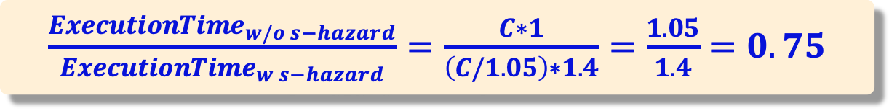
Structural Hazards – Cost of Stalls
Suppose data references represent 40% of the instructions, and the CPI is 1 when no structural hazard. Assume that the processor with the hazard has a clock rate that is 1.05 times higher than the hazard free processor, and incurs a one cycle stall on structural hazards. Is the pipeline with or without the structural hazard faster?
W/o s-hazard: Clock cycle = C, CPI = 1
W. s-hazard: Clock cycle = C/1.05, CPI = 1 + (0.4 * 1) = 1.4
$\frac{ExecutionTime_{w/o s−hazard}}{ExecutionTime_{w s−hazard}}=\frac{C∗1}{\left(C/1.05\right)∗1.4}=\frac{1.05}{1.4}=0.75$
C.2, 3.1 Pipeline hazards
Notes:
Processors that allow S-hazards potentially run slower due to stall cycles to handle S-hazards.

Slide 17
Data Hazards

Slide 18
Data Hazards
Source or destination operands of an instruction are not available, when needed in the pipeline
Example
addi X2, X3, 100 ; X2 <- [X3] + 100
subi X9, X2, 30 ; X9 <- [X2] - 30
First instruction writes to register X2 in the WB stage
Second instruction reads register X2 in the ID stage
To obtain the correct result, second instruction needs to wait in ID until the first instruction has written to X2
C.2, 3.1 Pipeline hazards
Notes:
registers needed by a later instruction are not available
those registers may provide source operands or destination.

Slide 19
Data Hazards
addi X2, X3, 100
subi X9, X2, 30
subi is stalled in decode stage for two additional cycles to delay reading X2 until the new value of X2 has been written by addi
Control circuitry recognizes the data dependency when it decodes subi (comparing source register ids with dest. register ids of prior instructions)
During cycles 3 to 5:
addi proceeds through the pipe
subi is held in the ID stage
In cycle 5, addi writes x2 in the first half cycle, subi reads x2 in the second half cycle
C.2, 3.1 Pipeline hazards

Slide 20
Types of Data Hazards
Read After Write (RAW) <-- True dependence
Caused by “data dependence”. Subsequent instruction needs data produced by earlier instruction
Write after Read (WAR) <-- False dependence
Called “anti-dependence”. Can’t occur in in-order pipelines (e.g., our simple MIPS pipeline). Occurs in advanced pipelines
Write after Write (WAW) <-- False dependence
Called “output dependence”. Can’t occur in in-order pipelines (e.g., our simple MIPS pipeline). Occurs in advanced pipelines
C.2, 3.1 Pipeline hazards

Slide 21
Types of Data Hazards - RAW
Inst j reads operand before Inst i write it (j > i)
This hazard results from a true dependence: data flow from instruction i to instruction j
Instr i: addi x1, x2, x3
Instr j: subi x4, x1, x3
C.2, 3.1 Pipeline hazards

Slide 22
Types of Data Hazards – WAR
Inst j writes operand before Inst i reads it (j > i)
WAR hazards cannot happen in MIPS 5-stage pipeline:
Instructions are executed in order
Register reads happen earlier (stage-2) than register writes (stage-5)
Instr i: sub x4, x1, x3
Instr j: add x1, x2, x3
C.2, 3.1 Pipeline hazards
Notes:
This is an anti-dependence (not a true dependence)
Arises from the reuse of register X1
If Instr j writes to x1 before Instr i reads x1, then Instr i will use the value written by Instr j => Incorrect behavior

Slide 23
Types of Data Hazards - WAW
Instr j writes to operand before Instr i writes to it (j > i)
WAW hazards cannot happen in MIPS 5-stage pipeline because:
Instructions are executed in order
Register writes are always in stage-5
Instr i: sub x1, x4, x3
Instr j: add x1, x2, x3
C.2, 3.1 Pipeline hazards
Notes:
This is an output dependence (not a true dependence)
Arises from the reuse of register x1
If Instr j writes to x1 before Instr i then Instr k will use the value written by Instr i => violation of program order

Slide 24
Data Hazards – Stall Penalty
addi x2, x3, 100
subi x9, x2, 30
If the dependent instruction follows right after the producer instruction, we need to stall the pipe for 2 cycles
Stall penalty = 2
C.2, 3.1 Pipeline hazards

Slide 25
Data Hazards – Stall Penalty
addi x2, x3, 100
or x4, x5, x6
subi x9, x2, 30
In this case, stall penalty = 1
Stall penalty depends upon the distance between the producer and dependent instruction
C.2, 3.1 Pipeline hazards

Slide 26
Reduce Stall Penalty – Forwarding
Frequent stalls caused by data hazards can impact the performance significantly.
Example: 2 stall cycles for every 5 instructions, then the CPI can increase by (1/5)*2 = 0.4 stall cycles
To avoid stalls caused by RAW hazards: forwarding
Also called “bypassing” or “short-circuiting”
Key Idea: Forward results from later stages in the pipeline to earlier stages
C.2, 3.1 Pipeline hazards

Slide 27
Forwarding – Basic Idea
The result of producer instruction is available at end of EX stage
Result forwarded to dependent instruction at the start of its EX
The arrow in below figure shows data being forwarded from EX stage of first instruction to EX stage of the second instruction
addi x2, x3, 100
subi x9, x2, 30
C.2, 3.1 Pipeline hazards
Notes:
sources of data that are needed by a following instruction: output of EX or MEM

Slide 28
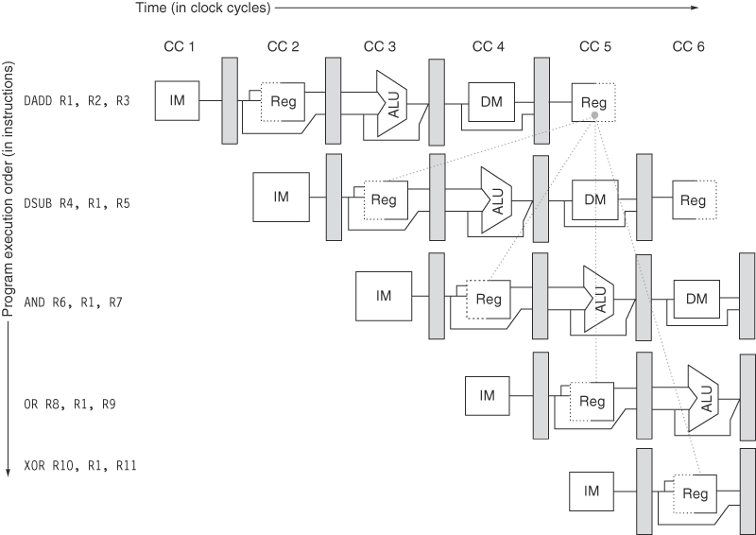
Data hazards
No data hazards
C.2, 3.1 Pipeline hazards

Slide 29
Data forward path
C.2, 3.1 Pipeline hazards

Slide 30
Passing results from one stage to inputs of another stage
C.2, 3.1 Pipeline hazards

Slide 31
Data Hazard Requiring Stalls
C.2, 3.1 Pipeline hazards

